Slide 1


Algorithm Development
Speech Corruption Recovery
Team Carpe Noctem

Slide 2
Agenda
Introduction & Problem Statement
Part 1 Decision Tree
  Analysis
Part 2 Decision Tree
  Analysis
_{CL}

Slide 3
Introduction & Problem Statement
TDC1 Quarter 2 Team:
CARPE NOCTEM
Carlos Lazo
Christopher Rappa
Michael Sangillo
Jake Tisdale
_{CL}

Slide 4
Introduction & Problem Statement
Speech Enhancement Problem
  Characterization of corruption in speech signals
Part 1 – Signal Corruption Assessment
  Given 2 signals, assess nature of corruption
  Create algorithm to clean signal
Part 2 – Simulated Transmission Channel
  Given an input signal, pass signal through ELDP function (transmission channel) with an integer representing corruption level
_{CL}

Slide 5
Part 1 – DECISION TREE
PROBLEM ANALYSIS
FUNCTION
CHARACTERIZATION
ALGORITHM ANALYSIS
ALGORITHM
OPTIMIZATION
VERIFICATION
CODE UNIFICATION
OUTPUT & RESULTS
_{CL}

Slide 6
Part 1 – Problem Analysis
PROBLEM ANALYSIS
FUNCTION
CHARACTERIZATION
Corrupted Sound Files → Algorithm → Uncorrupted (Clean) Sound Files
Corruption method equivalent for p1s1 and p1s2
Develop algorithm to decrease/eliminate corruption
ALGORITHM ANALYSIS
ALGORITHM
OPTIMIZATION
VERIFICATION
CODE UNIFICATION
OUTPUT & RESULTS
_{JT}

Slide 7
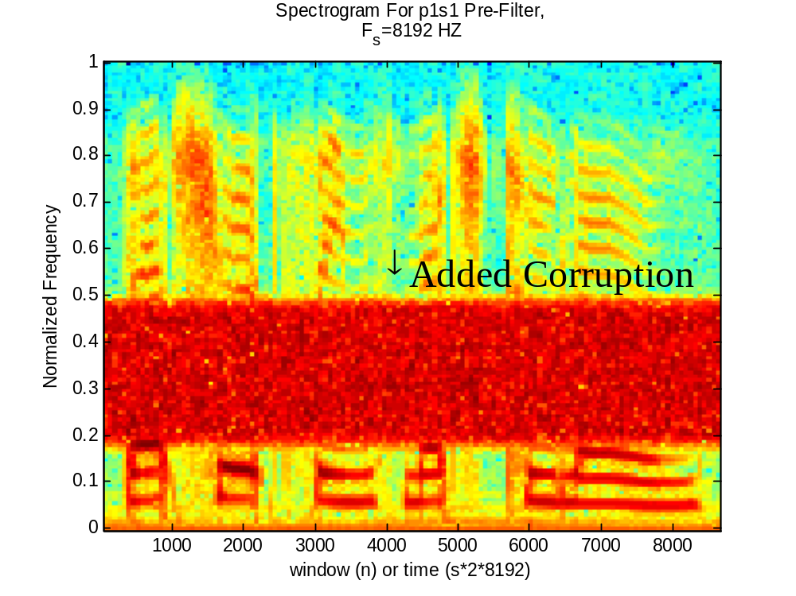
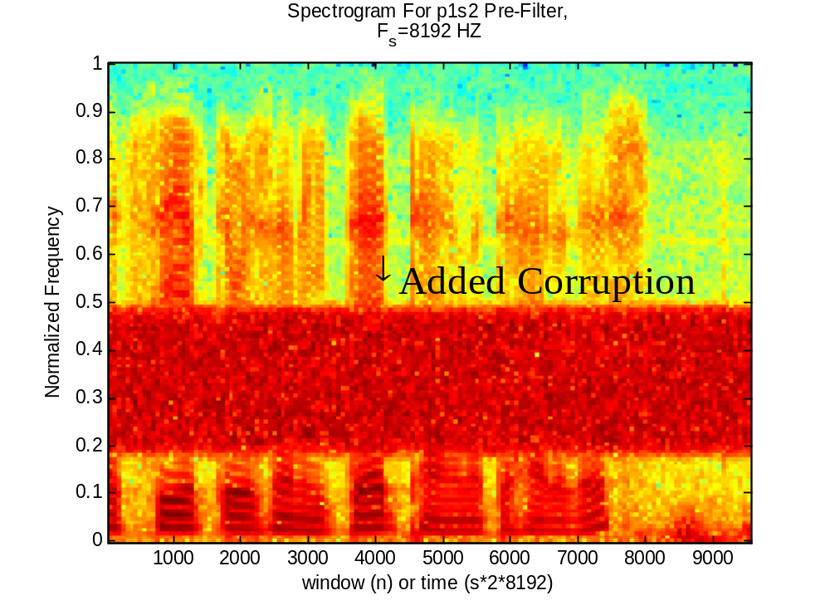
Part 1 – Function Characterization
PROBLEM ANALYSIS
FUNCTION
CHARACTERIZATION
ALGORITHM ANALYSIS
ALGORITHM
OPTIMIZATION
VERIFICATION
CODE UNIFICATION
OUTPUT & RESULTS
_{JT → 11,13}

Slide 8
Part 1 – Algorithm Analysis
PROBLEM ANALYSIS
FUNCTION
CHARACTERIZATION
Design a filter that eliminates signal corruption in shown frequency band
Use a band-stop filter
ALGORITHM ANALYSIS
ALGORITHM
OPTIMIZATION
VERIFICATION
CODE UNIFICATION
OUTPUT & RESULTS
_{JT}

Slide 9
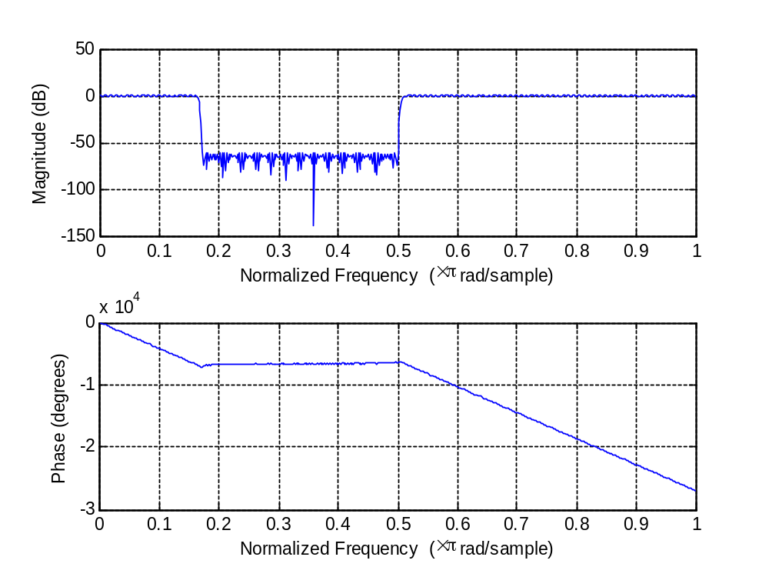
Part 1 – Algorithm
PROBLEM ANALYSIS
_{Filter Design}
FUNCTION
CHARACTERIZATION
ALGORITHM ANALYSIS
ALGORITHM
OPTIMIZATION
VERIFICATION
CODE UNIFICATION
OUTPUT & RESULTS
_{CR}

Slide 10
Part 1 – Verification
PROBLEM ANALYSIS
FUNCTION
CHARACTERIZATION
Verification of success through:
  audio playback
  spectrogram visualization
ALGORITHM ANALYSIS
ALGORITHM
OPTIMIZATION
VERIFICATION
CODE UNIFICATION
OUTPUT & RESULTS
_{CR}

Slide 11
Part 1 – Optimization
PROBLEM ANALYSIS
FUNCTION
CHARACTERIZATION
Stop band gain adjusted for optimal audio quality
Pass band ripple minimized for optimal audio quality
ALGORITHM ANALYSIS
ALGORITHM
OPTIMIZATION
VERIFICATION
CODE UNIFICATION
OUTPUT & RESULTS
_{CR}

Slide 12
Part 1 – Code Unification
PROBLEM ANALYSIS
FUNCTION
CHARACTERIZATION
Code formatted to meet assignment requirements
Filter generated in code, not through FDA tool
ALGORITHM ANALYSIS
ALGORITHM
OPTIMIZATION
VERIFICATION
CODE UNIFICATION
OUTPUT & RESULTS
_{CR}

Slide 13
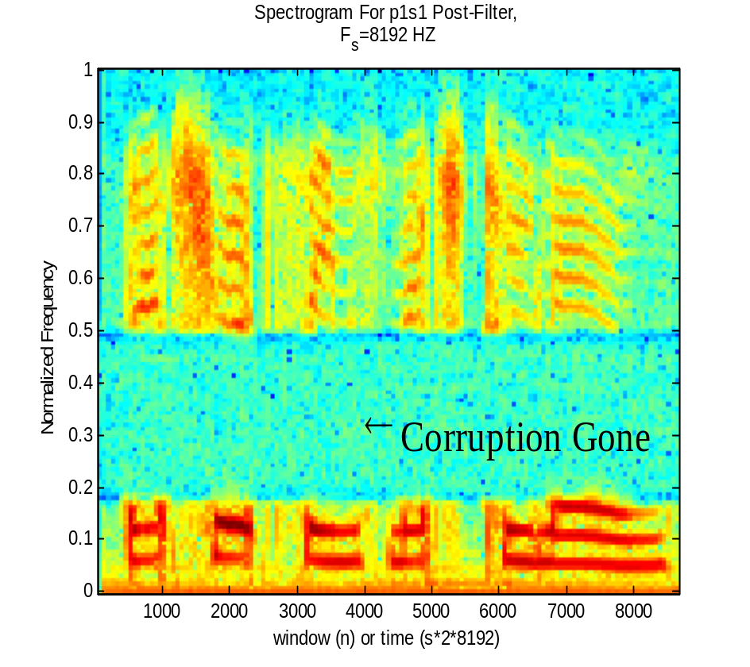
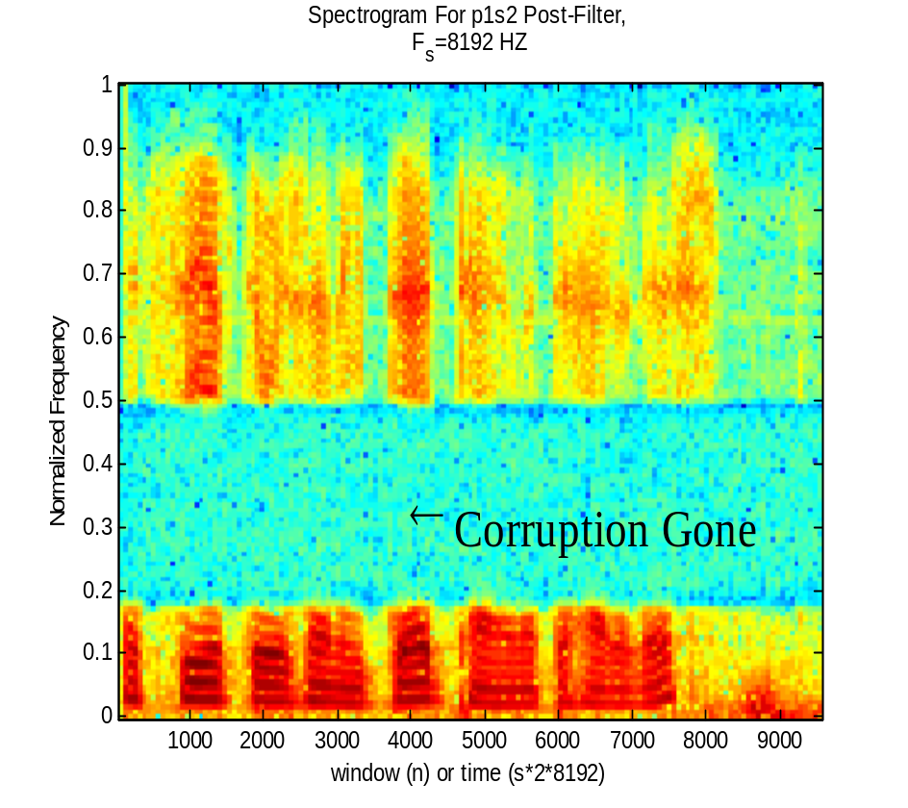
Part 1 – Output & Results
PROBLEM ANALYSIS
QUESTIONS?
FUNCTION
CHARACTERIZATION
ALGORITHM ANALYSIS
ALGORITHM
OPTIMIZATION
VERIFICATION
CODE UNIFICATION
OUTPUT & RESULTS
_{CR – 11→12,13→14}

Slide 14
Part 2 – Decision Tree
PROBLEM
ANALYSIS
PROBLEM
ANALYSIS
ELDP FUNCTION CHARACTERIZATION (1/2/3)
&
ALGORITHM ANALYSIS
ELDP FUNCTION CHARACTERIZATION (1/2/3)
&
ALGORITHM ANALYSIS
CORRUPTION
LEVEL 1 & 2
CORRUPTION
LEVEL 1 & 2
CORRUPTION
LEVEL 3
CORRUPTION
LEVEL 3
ALGORITHM
ALGORITHM
OPTIMIZATION
OPTIMIZATION
VERIFICATION
VERIFICATION
ALGORITHM
ALGORITHM
OPTIMIZATION
OPTIMIZATION
VERIFICATION
VERIFICATION
CODE
UNIFICATION
OUTPUT
&
RESULTS
_{CL}

Slide 15
Part 2 – Problem Analysis
PROBLEM
ANALYSIS
ELDP FUNCTION CHARACTERIZATION (1/2/3)
&
ALGORITHM ANALYSIS
Emulated transmission channel through ELDP function
  3 levels of corruption
Characterize/monitor output for 3 levels
Algorithm development decision based on characterization
CORRUPTION
LEVEL 1 & 2
CORRUPTION
LEVEL 3
ALGORITHM
OPTIMIZATION
VERIFICATION
ALGORITHM
OPTIMIZATION
VERIFICATION
CODE
UNIFICATION
OUTPUT
&
RESULTS
_{CL}

Slide 16
Part 2 – ELDP Function Char. + Alg. Analysis
PROBLEM
ANALYSIS
ELDP FUNCTION CHARACTERIZATION (1/2/3)
&
ALGORITHM ANALYSIS
CORRUPTION
LEVEL 1 & 2
CORRUPTION
LEVEL 3
ALGORITHM
OPTIMIZATION
VERIFICATION
ALGORITHM
OPTIMIZATION
VERIFICATION
CODE
UNIFICATION
OUTPUT
&
RESULTS
_{CL}

Slide 17
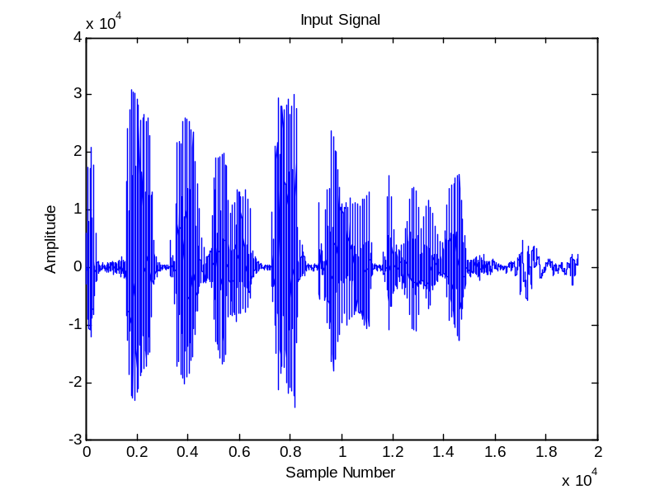
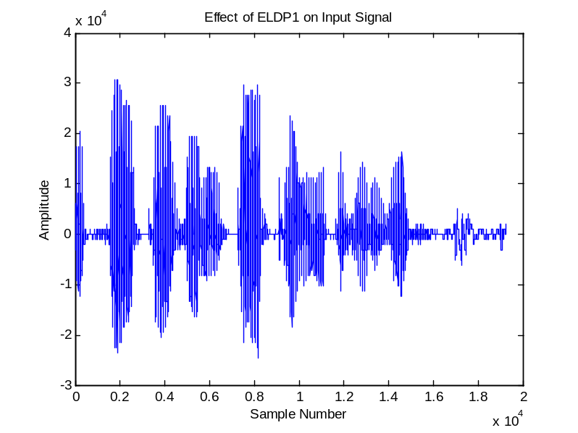
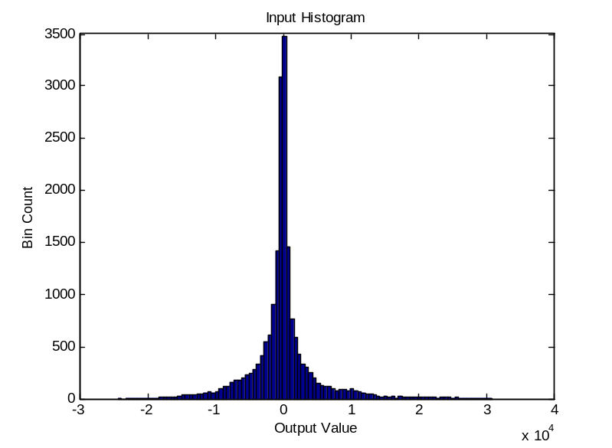
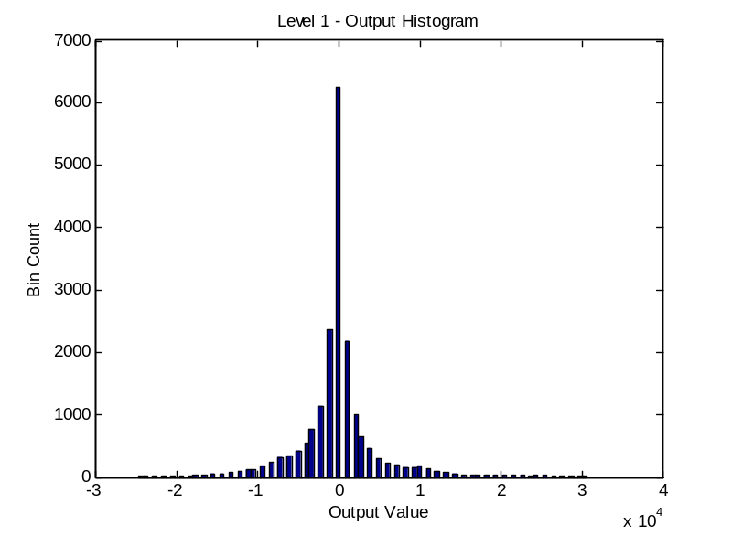
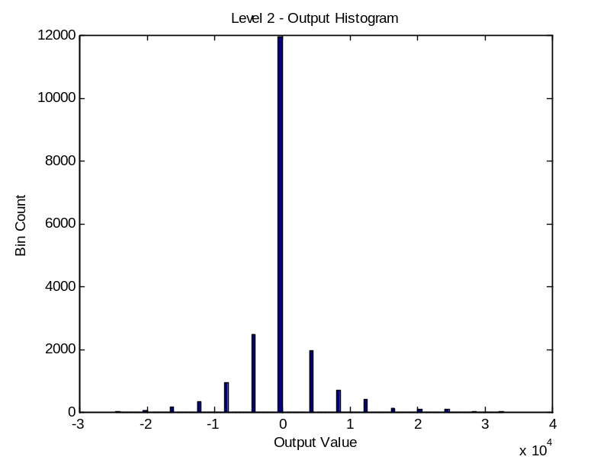
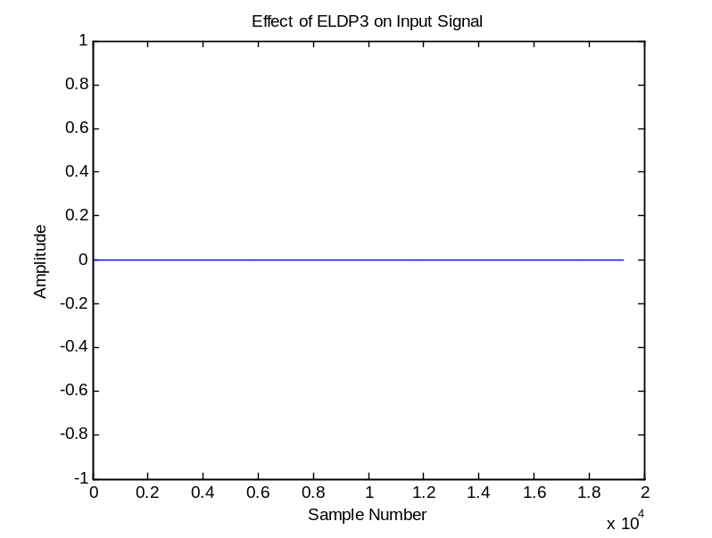
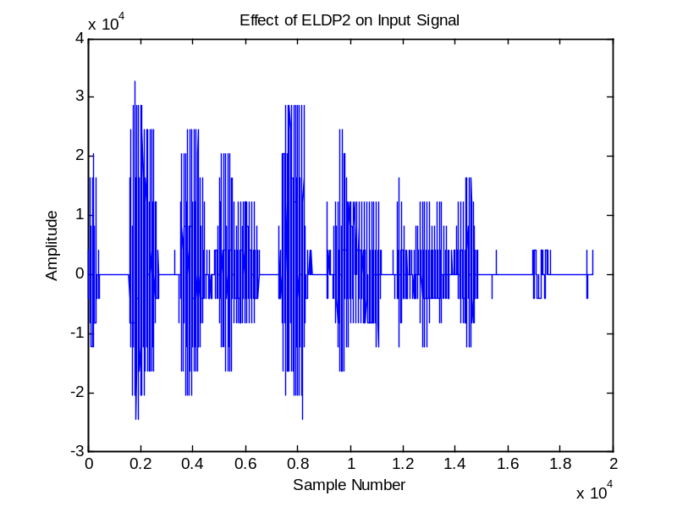
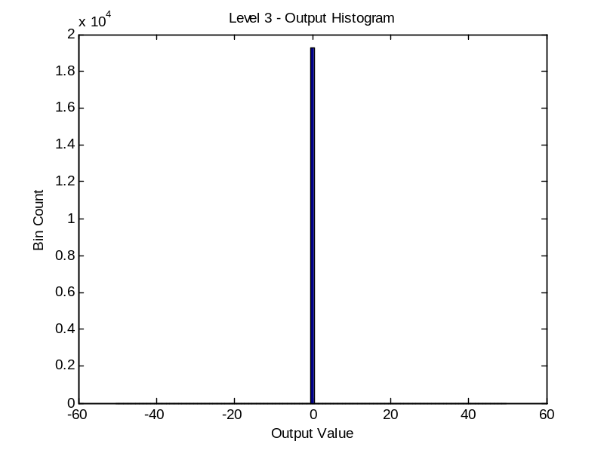
Part 2 – ELDP Function Char. + Alg. Analysis
₁
₃
₂
_{CL – 31,32,33,34}

Slide 18
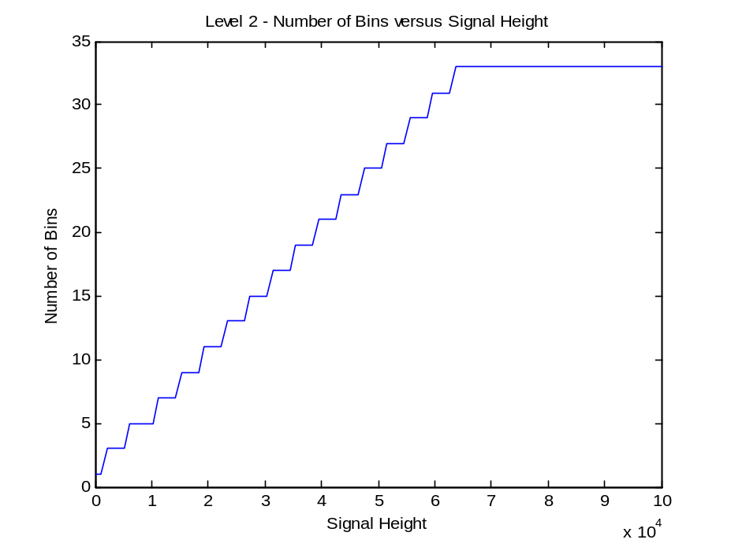
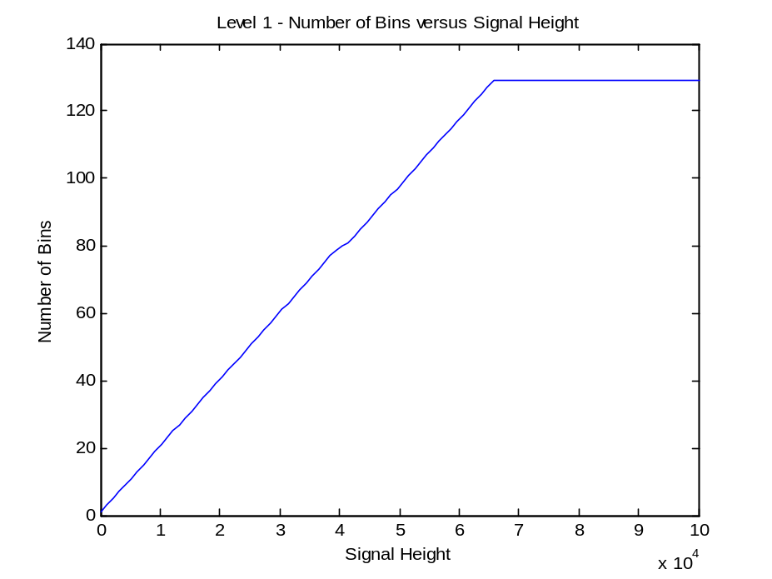
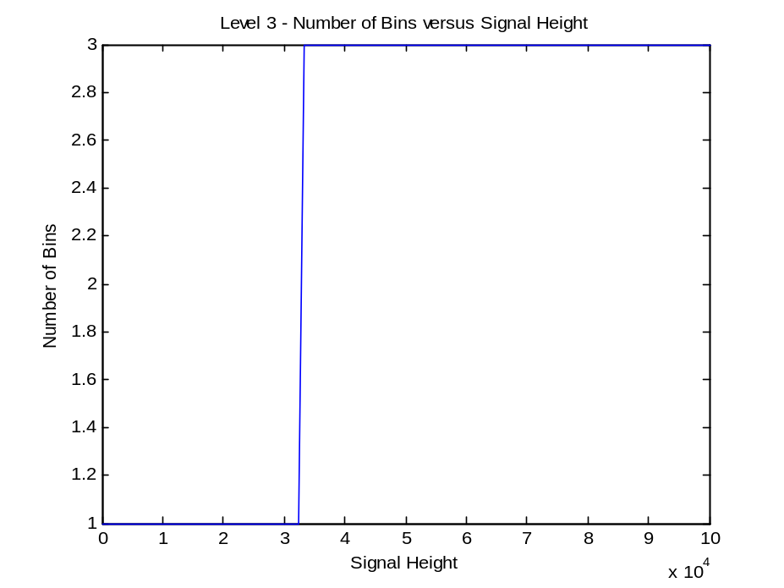
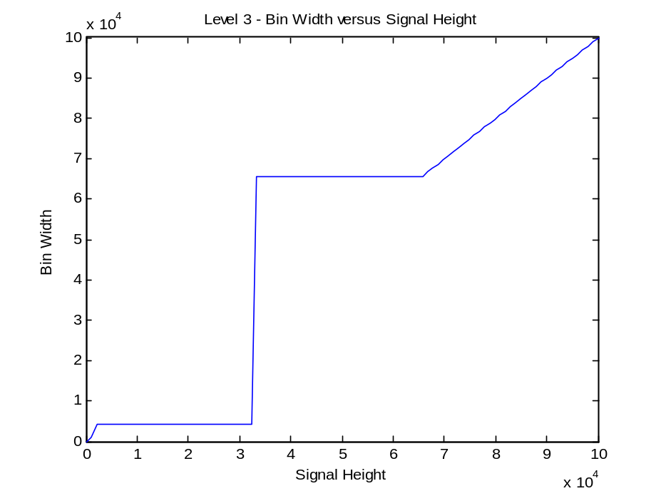
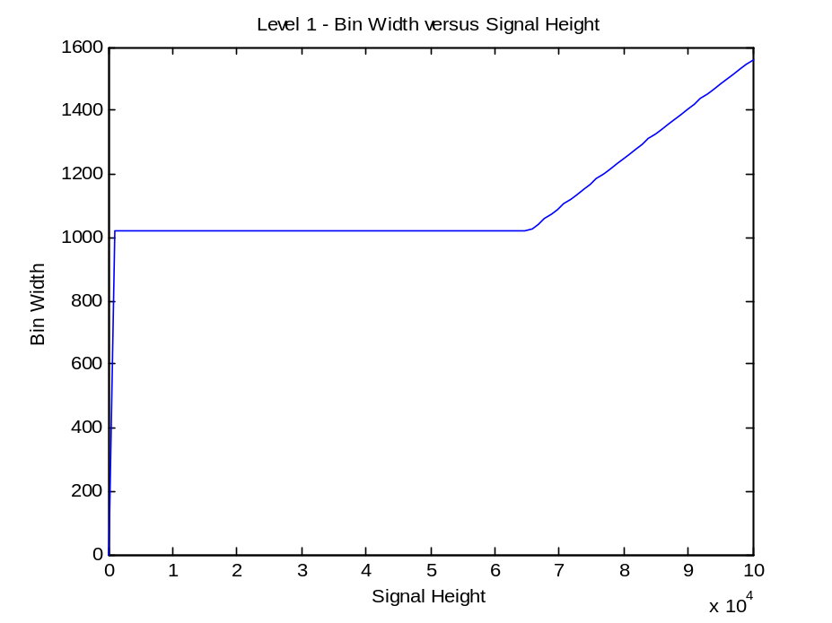
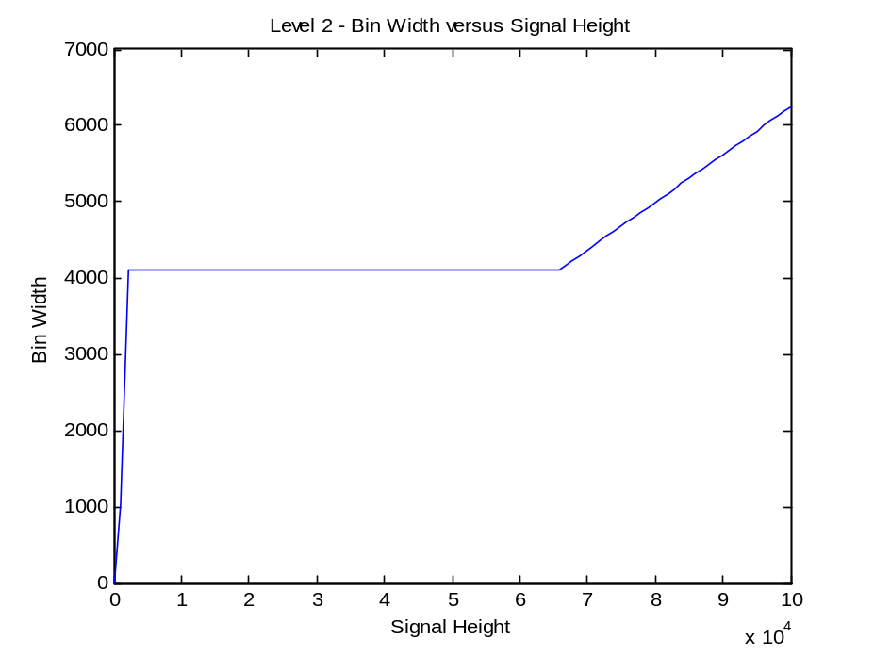
Part 2 – ELDP Function Char. + Alg. Analysis
_{JT/CL}

Slide 19
Part 2 – Corruption Level 3 → Algorithm
PROBLEM
ANALYSIS
ELDP FUNCTION CHARACTERIZATION (1/2/3)
&
ALGORITHM ANALYSIS
Pre-Processing
  Trinary encoding (base conversion)
Post-Processing
  Trinary decoding (base conversion)
CORRUPTION
LEVEL 1 & 2
CORRUPTION
LEVEL 3
ALGORITHM
OPTIMIZATION
VERIFICATION
ALGORITHM
OPTIMIZATION
VERIFICATION
CODE
UNIFICATION
OUTPUT
&
RESULTS
_{MS}

Slide 20
Part 2 – Corruption Level 3 → Algorithm
TRINARY BIT 1
TRINARY BIT 3
TRINARY BIT 2
TRINARY START
A = 100000
A = 100000
100000
100000
ENC = 1
BIN # 1
1/3 A
ENC = 1
1/3 A
ENC = 0
5/27 A
ENC = 1
4/27 A
ENC = - 1
1/9 A
ENC = 0
0
BIN # 2
0
0
ENC = 0
0
-1/9 A
ENC = - 1
-1/3 A
-1/3 A
ENC = - 1
BIN # 3
-100000
-100000
-100000
-100000
0
0
0
1
_{MS}
TRINARY 3-BIT ENCODING:
1
-1
TRINARY 3-BIT ENCODING:
TRINARY 3-BIT ENCODING:
TRINARY 3-BIT ENCODING:

Slide 21
Part 2 – Corruption Level 3 → Verification
PROBLEM
ANALYSIS
ELDP FUNCTION CHARACTERIZATION (1/2/3)
&
ALGORITHM ANALYSIS
Universal metric for signal comparison
  Normalized standard deviation
CORRUPTION
LEVEL 1 & 2
CORRUPTION
LEVEL 3
ALGORITHM
OPTIMIZATION
VERIFICATION
ALGORITHM
OPTIMIZATION
VERIFICATION
CODE
UNIFICATION
OUTPUT
&
RESULTS

Slide 22
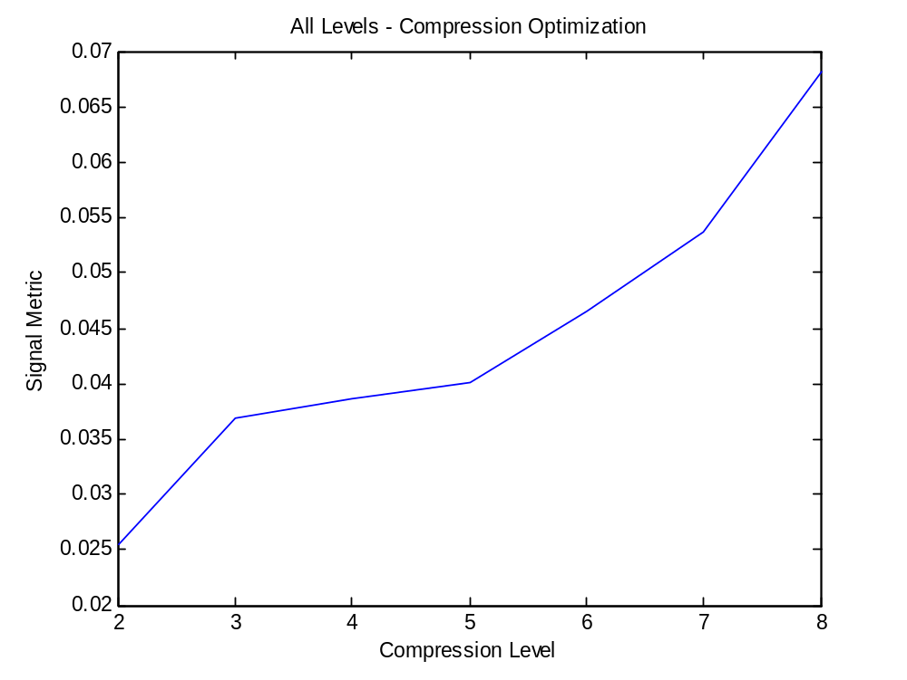
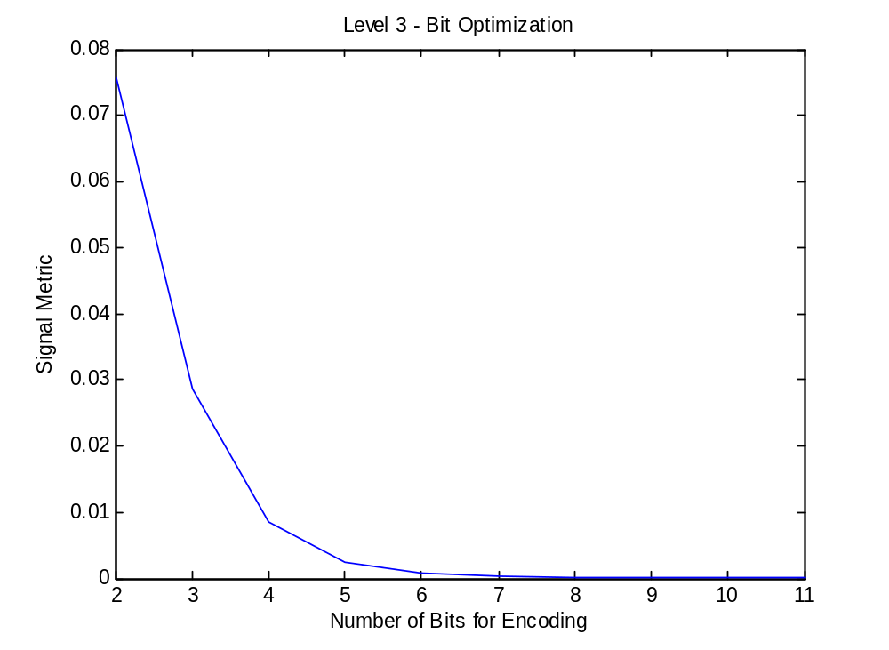
Part 2 – Corruption Level 3 → Optimization
PROBLEM
ANALYSIS
Lossless Compression
  Burrows-Wheeler Transform
    Searches for repeated strings and sorts them together
    After the B-W transformation the new string can be compressed more by eliminating redundancies
  Run-Length Encoding
    Runs of data are stored as single value and count
    Only practical for data streams with repeating data, otherwise it would extend the string length
Lossy Compression
  Downsample
    Reduction of resolution in the time domain.
  Wavelet Transformation
    Transforms data into scaled coefficients with respect to frequency
    Good for non-periodic signals
  Discrete Cosine Transformation
    Similar to Discrete Fourier Transform
    Summation of N Cosines with respect to frequency
ELDP FUNCTION CHARACTERIZATION (1/2/3)
&
ALGORITHM ANALYSIS
CORRUPTION
LEVEL 1 & 2
CORRUPTION
LEVEL 3
ALGORITHM
OPTIMIZATION
VERIFICATION
ALGORITHM
OPTIMIZATION
VERIFICATION
CODE
UNIFICATION
OUTPUT
&
RESULTS
_{MS/CR – 42, 44, 46, 52,55,58}

Slide 23
Part 2 – Corruption Level 1 & 2 → Algorithm
PROBLEM
ANALYSIS
ELDP FUNCTION CHARACTERIZATION (1/2/3)
&
ALGORITHM ANALYSIS
Near copy of Corruption Level 3 PCM (pulse-code modulation) encoding
  Uses 129 bin encode/decode scheme for Part 1
  Uses 33 bin encode/decode scheme for Part 2
CORRUPTION
LEVEL 1 & 2
CORRUPTION
LEVEL 3
ALGORITHM
OPTIMIZATION
VERIFICATION
ALGORITHM
OPTIMIZATION
VERIFICATION
CODE
UNIFICATION
OUTPUT
&
RESULTS
_{JT}

Slide 24
Part 2 – Corruption Level 1 & 2 → Verification
PROBLEM
ANALYSIS
ELDP FUNCTION CHARACTERIZATION (1/2/3)
&
ALGORITHM ANALYSIS
Metric comparison of output confirmed that result was an audible signal
  Comparisons made to other waveforms to confirm
CORRUPTION
LEVEL 1 & 2
CORRUPTION
LEVEL 3
ALGORITHM
OPTIMIZATION
VERIFICATION
ALGORITHM
OPTIMIZATION
VERIFICATION
CODE
UNIFICATION
OUTPUT
&
RESULTS
_{CR}

Slide 25
Part 2 – Corruption Level 1 & 2 → Optimization
PROBLEM
ANALYSIS
ELDP FUNCTION CHARACTERIZATION (1/2/3)
&
ALGORITHM ANALYSIS
Examined compression’s effect on overall output
CORRUPTION
LEVEL 1 & 2
CORRUPTION
LEVEL 3
ALGORITHM
OPTIMIZATION
VERIFICATION
ALGORITHM
OPTIMIZATION
VERIFICATION
CODE
UNIFICATION
OUTPUT
&
RESULTS
_{CR}

Slide 26
Part 2 – Code Unification
PROBLEM
ANALYSIS
ELDP FUNCTION CHARACTERIZATION (1/2/3)
&
ALGORITHM ANALYSIS
Code formatted to meet assignment requirements
All parallel code unified into single deliverable file
  Single file calls other functions
CORRUPTION
LEVEL 1 & 2
CORRUPTION
LEVEL 3
ALGORITHM
OPTIMIZATION
VERIFICATION
ALGORITHM
OPTIMIZATION
VERIFICATION
CODE
UNIFICATION
OUTPUT
&
RESULTS
_{CR}

Slide 27
Part 2 – Output & Results
QUESTIONS?
PROBLEM
ANALYSIS
 | Output | Clean
Level 1 | 9.82E-03 | 7.44E-05
Level 2 | 3.84E-02 | 1.16E-03
Level 3 - 2 Bits | NaN | 7.88E-02
Level 3 - 4 Bits | - | 7.46E-03
Level 3 - 6 Bits | - | 9.17E-04
Compress 2 | - | 2.55E-02
Compress 5 | - | 4.01E-02
Compress 6 | - | 6.81E-02
ELDP FUNCTION CHARACTERIZATION (1/2/3)
&
ALGORITHM ANALYSIS
Level 1 → 129 symbol 2 bit encoding scheme sufficient to show no notable (audible) difference between input and output files.
Level 2 → 33 symbol 2 bit encoding scheme sufficient to show no notable (audible) difference between input and output files.
Level 3 → Optimal # of encoded bits for discernable audio = 6
CORRUPTION
LEVEL 1 & 2
CORRUPTION
LEVEL 3
ALGORITHM
OPTIMIZATION
VERIFICATION
ALGORITHM
OPTIMIZATION
VERIFICATION
CODE
UNIFICATION
OUTPUT
&
RESULTS
_{CR -35,36,46}

